Slide 1
Web3athon-A crypto hackathon IOT Project - Air Quality Monitoring System
Team name:-Cryptohackers
Team members:-Mohamed Farhun M(Leader)
Premkumar S (Member)
Navin P(Member)

Slide 2
Introduction
Harmful substances are mixed into the air to cause air pollution.
The main issue facing every country, developed or developing, is air pollution.
Particularly in urban regions of emerging countries, where industrialization and an increase in the number of cars lead to the discharge of several gaseous pollutants, health issues have been escalating more quickly.

Slide 3

Problem statement
To design an IOT based Air Pollution Monitoring System which used to monitor and analyse air quality real-time and log data to the cloud,keeping the data updated over the internet.
Air quality measurements are taken based on the Parts per million metrics.

Slide 4
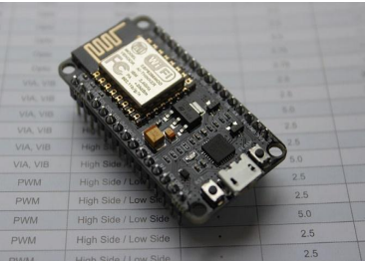
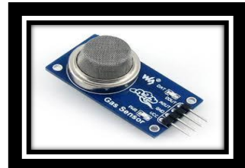
Materials required
HARDWARE REQUIREMENTS:-
Node MCU MQ135 Gas sensor

Slide 5
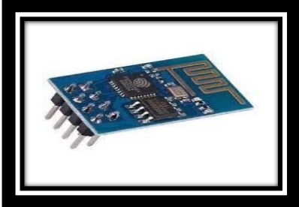

Hardware requirements
Wi-Fi Module Arduino Uno

Slide 6
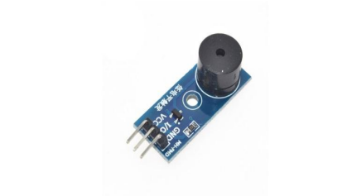
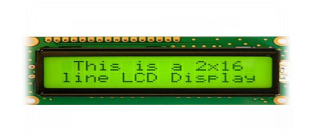
HARDWARE REQUIREMENTS
LCD Display Buzzer

Slide 7
Working
Our model is to be installed into every vehicle to get real time pollution data of individual vehicle.
The MQ135 gas sensor recognises the data of emission level.
The MQ135 sensor can detect substances like CO2, SO2, NH3, NOx, alcohol, Benzene, and smoke.
For our air pollution, it is therefore a dynamic gas sensor monitoring apparatus.
When will it be coupled with Node? MCU will then detect all gases and provide the pollutant load. The output from the MQ135 gas sensor will be in voltage levels, which must be transformed into PPM (parts per million).
The value is read using a gas sensor voltage which needs to be converted into ppm. If the amount of Vehicle emissions exceed the specified limit, and the buzzer will begin to beep.

Slide 8
Working
Node MCU is a very cheap device and do serve the need of ESP8266
When there is no gas nearby and the emission level is safe up to 350 PPM but should not exceed 1000 PPM, the sensor returns a result of 90.
When it goes over the 1000 PPM limit, it will result in headaches, drowsiness, and stuffy, stagnant air.
It will increase heart rate and lead to a number of ailments if it exceeds 2000 PPM.
The LCD and website will indicate "Good Air" when the figure is less than 1000 PPM.
When the PPM levels exceed 1000, the buzzer will begin to sound, and "Poor Air, Alert" will be displayed on the LCD and website. And after it reaches 2000, the buzzer will continue to beep and send an alert message over GSM to a smartphone.

Slide 9
Features | Previous related works | Proposed Model
Checking environmental parameters to be measured |  | ✓
Study the characteristic features on the sensor device |  | ✓
Decision making on sensing, measuring and fixing the threshold value for the parameters |  | ✓
Storing the data in cloud |  | ✓
Calculating the Air quality index |  | ✓
Providing information via SMS |  | ✓
Predicting the AQI using Machine learning |  | ✓
Paper1 ✓ | Paper2 ✓ | Paper3 ✓
✓ | ✓ | ✓
✓ | ✓ | ✓
✘ ✘ ✘ ✘ | ✓ ✘ ✘ ✘ | ✓ ✓ ✘ ✓

Slide 10
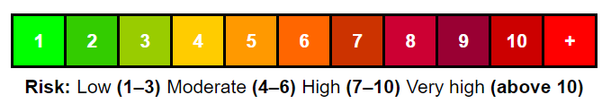

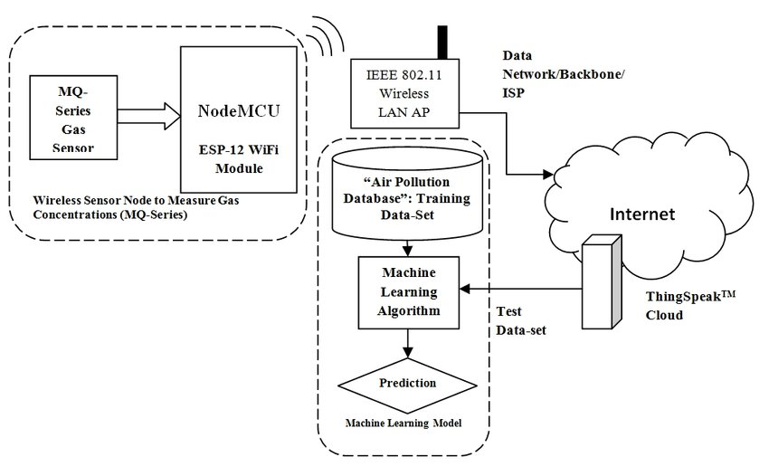
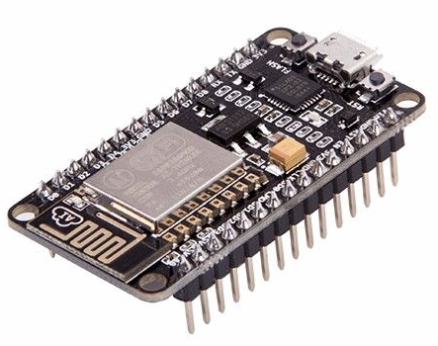




Architecture
Temperature sensor
Humidity sensor
Air Quality Gas Sensor
GPS
AQI calculation and Decision Making

Slide 11
THANKS
Team name:-Cryptohackers
Team members:-
Mohamed Farhun M(Leader)
Premkumar S (Member)
Navin P(Member)

